Slide 1



Wind Turbine Failure Analysis
Created By: Bharat Bhushan Swain
Batch :17092024 10AM
Institute : 360DigiTMG
Mini project presentation
Business Problem: Unplanned failure of wind turbine engine is leading to huge losses and electricity generation is negatively impacted.

Slide 2

Project Leadership
Sharat Manikonda
Director at Innodatatics and Sponsor
linkedin.com/in/sharat-chandra

Slide 3
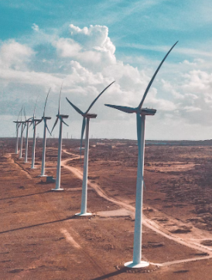
Contents
Business Problem
Project Architecture
Business Constraints
Success Criteria
Project Overview and Scope
Data dictionary
Exploratory Data Analysis
Data Pre-processing
Data Visualization
Notes:
Change

Slide 4
Business Problem
Main Objective: Predict and analyze failures in wind turbines to ensure timely maintenance.
Key Goals: Reduce operational downtime by identifying failure patterns early.
Optimize maintenance schedules to lower costs.
Improve turbine performance and energy output reliability.
Enhance safety and operational compliance.
Problem Statement: Unplanned turbine failures lead to significant maintenance costs and energy production losses.

Slide 5
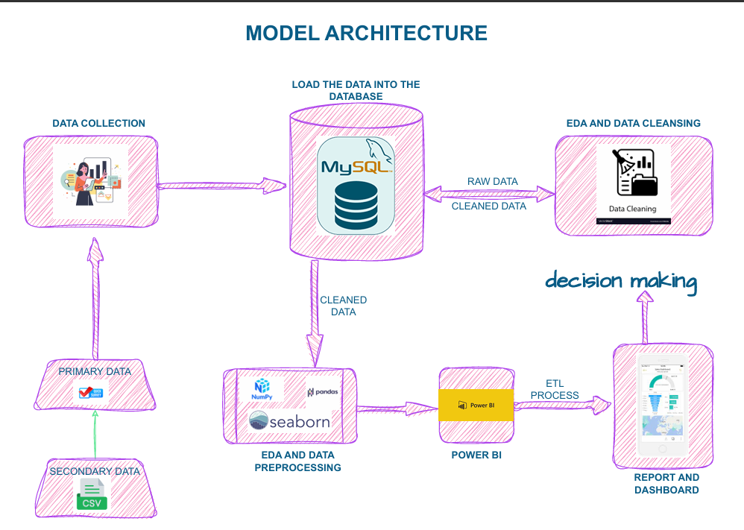
Project Architecture

Slide 6
Business Constraints
• Maximize Power Generation:
- Avoid interruptions during maintenance or repair.
• Economic and Operational Balance:
- Prevent high operational costs.
- Minimize downtime while maintaining output.

Slide 7
Success Criteria
1. Business Success:
- Reduce unplanned failures by at least 30%.
2. Economic Success:
- Achieve $2 million/year in cost savings through better maintenance and reduced downtime.

Slide 8
Project Overview and Scope
Overview: The project aims to predict and prevent wind turbine failures using historical sensor data. By leveraging machine learning, the goal is to optimize maintenance schedules, reduce downtime, and improve energy efficiency.
Scope:
Data: Analyze turbine parameters (e.g., wind speed, power output, temperatures).
Techniques: Perform EDA, feature engineering, and predictive modeling.
Deliverables: A failure detection model and actionable insights for operational
improvements.
Impact: Minimized downtime, reduced maintenance costs, and enhanced energy reliability.

Slide 9
Data Dictionary
Column Name | Description | Unit | Range | Scale | Relevance
date | Date of the observation | Date | N/A | Nominal | Temporal reference
Wind_speed | Wind speed near the turbine | m/s | ~7.8–43.8 | Ratio | Performance factor
Power | Power output of the turbine | kW | ~0.15–2.97 | Ratio | Key performance metric
Nacelle_ambient_temperature | Ambient temperature at the nacelle | °C | ~-56.0–40.0 | Interval | Performance and failure indicator
Generator_bearing_temperature | Temperature of the generator bearing | °C | ~46.8–89.5 | Interval | Reliability and wear
Gear_oil_temperature | Temperature of the gear oil | °C | ~50.0–112.2 | Interval | Lubrication and performance
Ambient_temperature | General ambient temperature | °C | ~-17.6–40.0 | Interval | Environmental factor
Rotor_Speed | Rotor speed | RPM | ~24.2–134.5 | Ratio | Efficiency indicator
Nacelle_temperature | Internal temperature of the nacelle | °C | ~-4.9–56.5 | Interval | Failure indicator
Bearing_temperature | Temperature of bearings | °C | ~15.8–100.0 | Interval | Maintenance trigger
Generator_speed | Speed of the generator | RPM | ~361.9–1456.0 | Ratio | Performance factor
Yaw_angle | Orientation angle of the nacelle | Degrees | ~13.5–165.9 | Interval | Operational alignment
Wind_direction | Direction of the wind relative to the turbine | Degrees | ~7.3–218.7 | Interval | Efficiency determinant
Wheel_hub_temperature | Temperature of the wheel hub | °C | ~-75.9–62.9 | Interval | Potential failure metric
Gear_box_inlet_temperature | Inlet temperature of the gearbox | °C | ~11.3–28.1 | Interval | Lubrication condition
Failure_status | Status of the turbine (failure or not) | Categorical | Failure/No_failure | Nominal | Binary classification target

Slide 10
Exploratory Data Analysis [EDA]
Univariate Analysis: Histograms and density plots for wind speed, rotor speed, and power output.
Bivariate Analysis: Scatterplots to observe relationships, e.g., Wind Speed vs. Power Output.
Correlation Heatmap: Analyzing variable relationships to identify strong predictors.
Insights: Failures increase at extreme wind speeds.
Rotor speed and nacelle temperature show strong correlations with power.
Notes:
EDA is used for seeing what the data can tell us before the modeling task.
Change

Slide 11
Data Preprocessing
Steps in Data Cleaning: Handle missing values with median imputation for numeric data.
Remove duplicate rows to ensure unique data points.
Treat outliers using the IQR method.
Feature Engineering: Add columns like:
Power-to-Speed Ratio: Power / Rotor Speed.
Temperature Difference: Nacelle Temperature - Ambient Temperature.
Scaling: StandardScaler for standardization.
MinMaxScaler for normalization.
Notes:
Keep observations

Slide 12
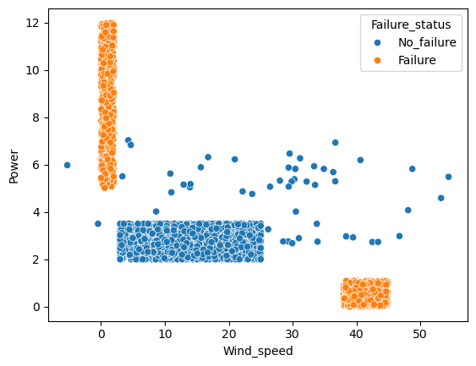
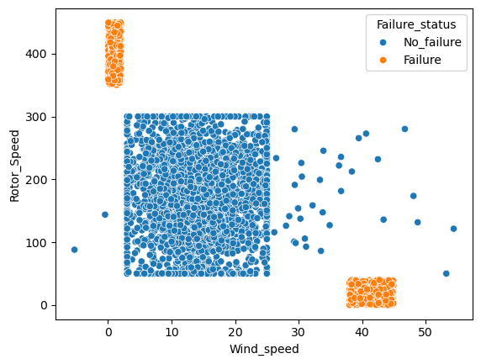
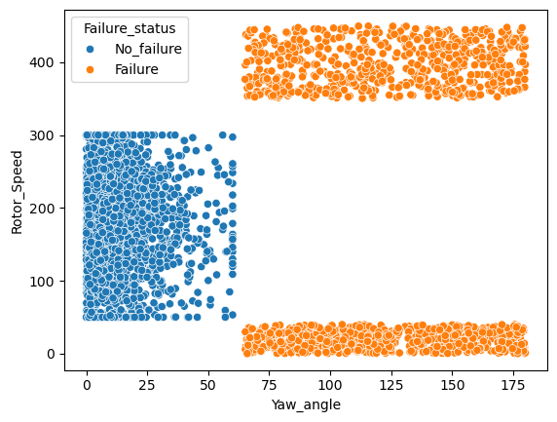
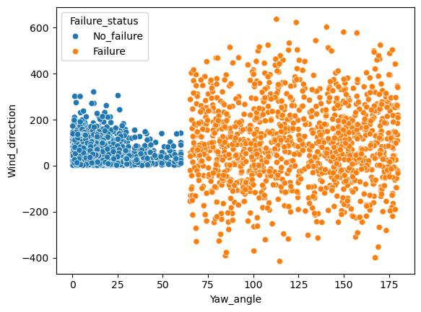
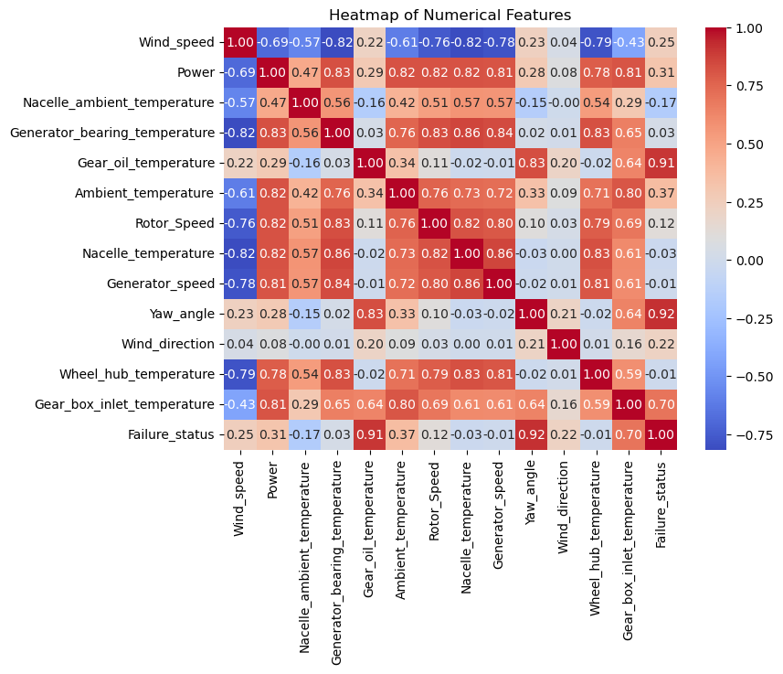
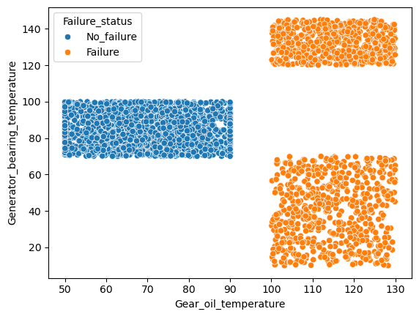
Data Visualization
Notes:
Add graphical

Slide 13


